Slide 1
Rockbuster stealth 2020 Company strategy data analysis
David ey

Slide 2



objective
Analyze available data to aid in strategy for launching a new online video rental service.

Slide 3
Business questions addressed
Which movies contributed the most/least to revenue gain?
What was the average rental duration for all videos?
Which countries are Rockbuster customers based in?
Where are customers with a high lifetime value based?
Do sales figures vary between geographic regions?

Slide 4
Some of Rockbuster’s basic data
599
TOTAL CUSTOMERS
(584 ACTIVE)
1000
FILMS IN ITS CATALOG
115
MINUTES AS AVERAGE LENGTH*
$2.98
AVERAGE EARNINGS FROM A FILM RENTAL
$19.98
AVERAGE COST OF REPLACING A FILM**
*Lengths range from 46-18 minutes; 85 minutes is the most common length
**Replacement costs range from $9.99-$29.99; $20.99 is the most common cost

Slide 5

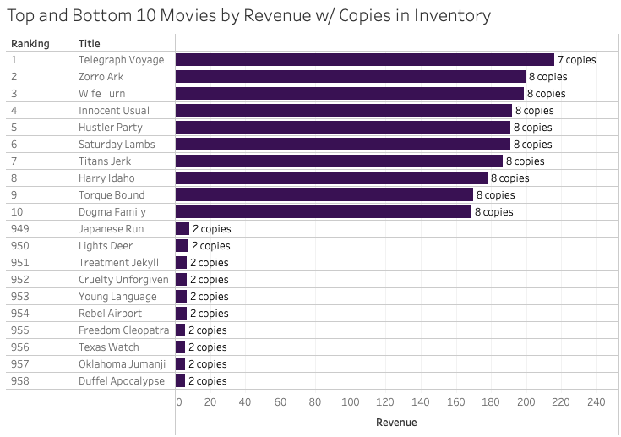
Top AND bottom 10 movies BY REVENUE
Notably, Rockbuster owns considerably more copies of the top movies than the bottom movies
See full graph in Tableau

Slide 6
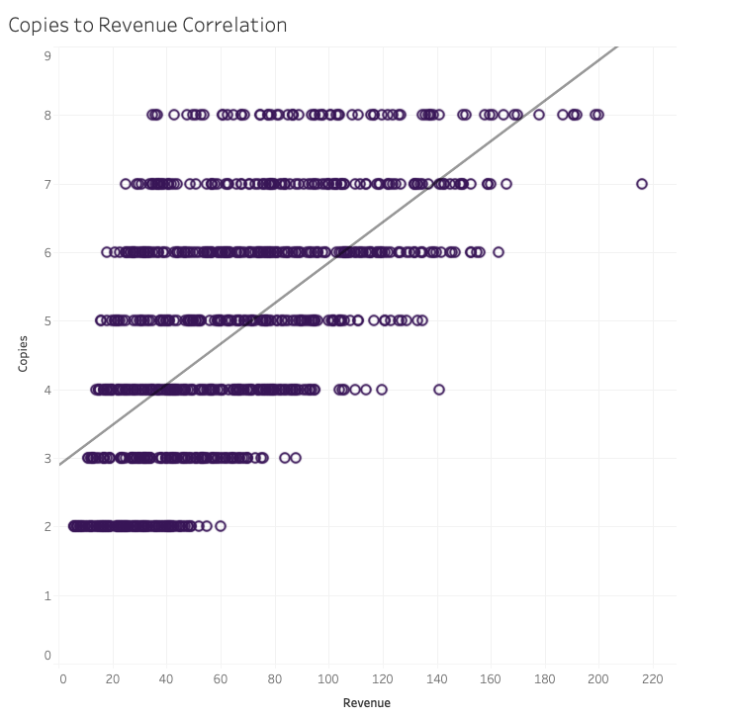

OPPORTUNITY: copies and revenue
There is a strong positive correlation* between the number of copies in our inventory and the revenue a movie generates
Thus. some movies may have generated more revenue had we purchased more copies
As such, we recommend that Rockbuster Stealth prioritize acquiring rights for movies that generated above average revenue per copy (more than approx. $13.41) instead of purely the highest winners in revenue
List attached below
*Correlation of 0.62, no outliers present
See full graph on Tableau

Slide 7
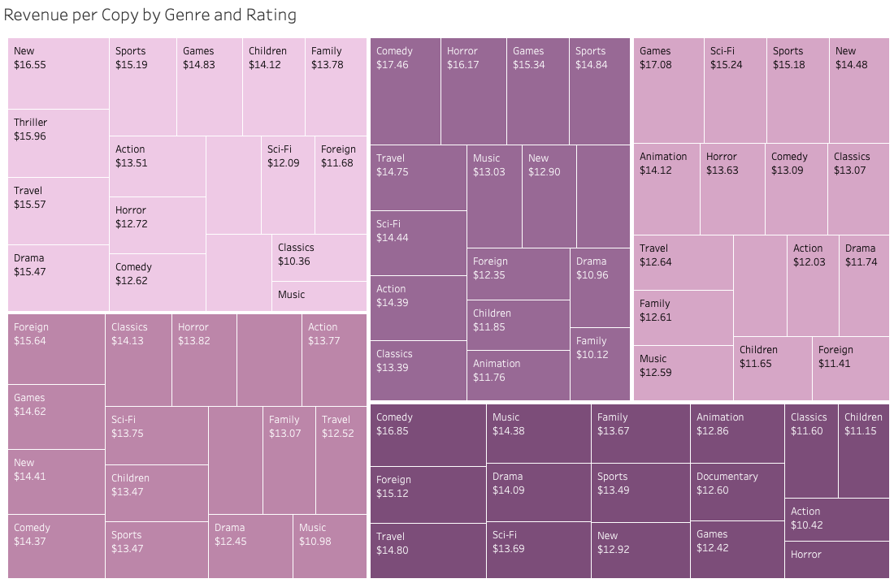
REVENUE per copy by rating and Genre
G
R
PG
Different genre/rating combinations bring more revenue per copy than others
On average, all ratings are similar:
G: $13.41
PG: $13.20
PG-13: $13.78
R: $13.60
NC-17: $13.17
FYI: Rockbuster’s most common film rating is PG-13, a good choice!
PG-13
NC-17
See full graph on Tableau

Slide 8

Average rental duration
4.99 DAYS AVERAGE
3 DAYS
MINIMUM
6 DAYS
MODE
7 DAYS MAXIMUM
Different factors could influence rental duration such as convenience and viewing behavior
As location of store and home could be a major factor in rental duration, it is difficult to make a recommendation on this subject with the data available

Slide 9

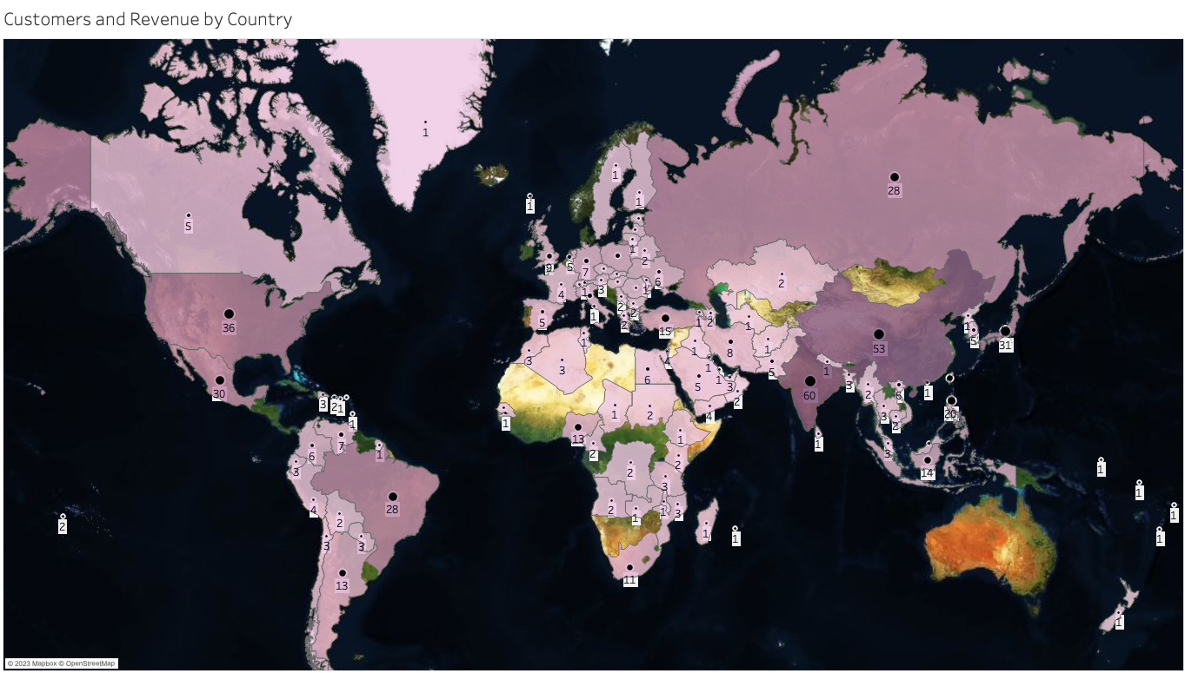
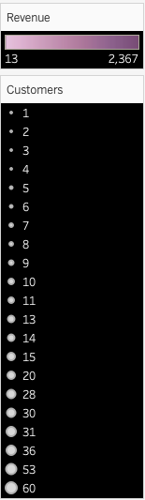
Rockbuster’s customers and spending
Rockbuster’s top countries for customers and revenue are:
Country | Customers | Revenue
India | 60 | $ 2,367.29
China | 53 | $ 2,089.80
United States | 36 | $ 1,344.31
Japan | 31 | $ 1,185.61
Mexico | 30 | $ 1,143.73
Brazil | 28 | $ 1,144.78
Russian Federation | 28 | $ 1,044.89
Philippines | 20 | $ 812.40
Turkey | 15 | $ 581.86
Indonesia | 14 | $ 548.92
See full graph on Tableau

Slide 10
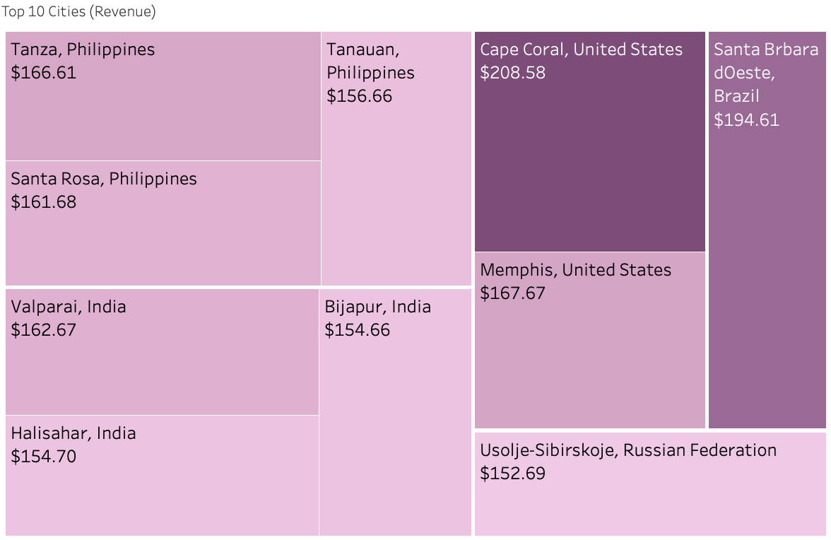






Rockbuster’s TOP cities in top 10 countries
All of Rockbuster’s top 10 cities by revenue were notably in the Philippines and India, followed by the US, Brazil, and Russia
It will be important to determine Rockbusters’ top cities internet availability; some cities may lack web infrastructure and be best served by rental stores.
See full graph on Tableau

Slide 11



Rockbuster’s TOP customers
Name |  | City | Total Paid (USD)
Karl | Seal | Cape Coral, FL | $208.58
Marion | Snyder | Santa Brbara dOeste | $194.61
Ana | Bradley | Memphis, TN | $167.67
Marcia | Dean | Tanza | $166.61
Mike | Way | Valparai | $162.67
Arnold | Havens | Santa Rosa | $161.68
Louis | Leone | Tanauan | $156.66
Lena | Jensen | Halisahar | $154.70
Tim | Cary | Bijapur | $154.66
Warren | Sherrod | Usolje-Sibirskoje | $152.69

Slide 12

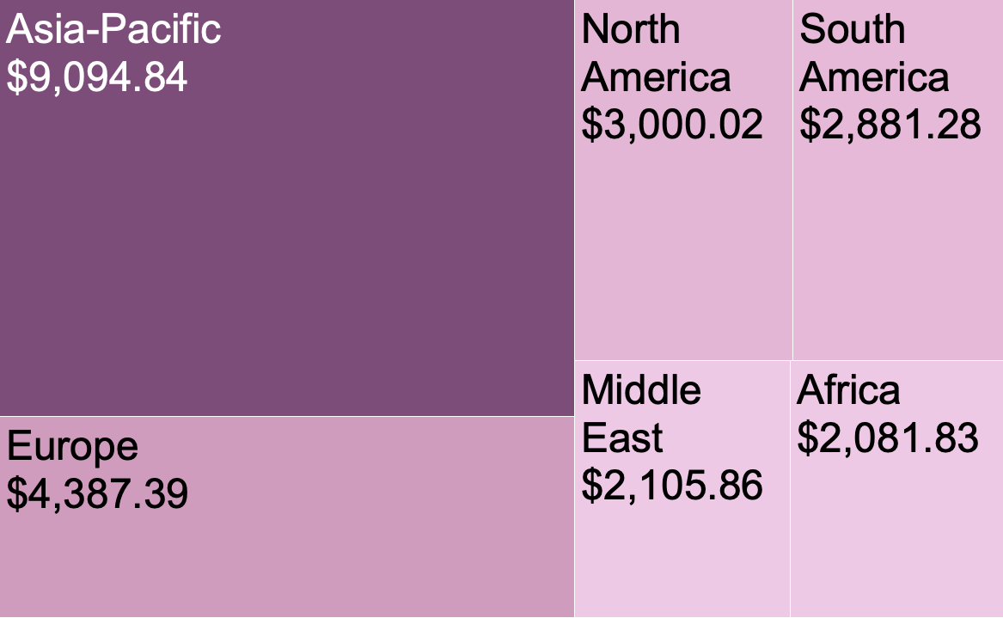
Revenue by region
Asia-Pacific is by far the most valuable region, followed by Europe
Both regions of the Americas brought in a similar amount of revenue
The Middle East and Africa tended to be the lowest
See full graph on Tableau

Slide 13
Recommendations and next steps
Rockbuster Stealth should:
Acquire streaming rights for movies that brought above average revenue per copy (see slide 6)
Prioritize certain genre/rating combinations accordingly (see slide 7)
Offer discounts to our top customers
Focus especially on Asia-Pacific as this has been Rockbuster Stealth’s strongest consumer base, but keep internet accessibility in mind: some of our customers may be better served by physical locations due to poor internet access
Rockbuster’s Next Steps could be:
Conduct market research in North America and Europe to determine demand for a streaming rental service
Consider incorporating critics’ and fans’ review scores into our dataset

Slide 14
THANK YOu

